Slide 1
Two Person Mechanics
USA LACROSSE OFFICIALS DEVELOPMENT
Notes:
In the Two-Person Mechanics lesson learn proper movement and mechanics needed to be in the correct position to make the call, administer penalties and support their partners in a two-person game.

Slide 2
What Are Mechanics?
Positioning
Where to Look
When to Blow the Whistle
Signals

Slide 3
Face-Off Positioning-Responsibilities
Run Left
F
Responsible for this Goal!!
Responsible for this Goal!!
W

Slide 4
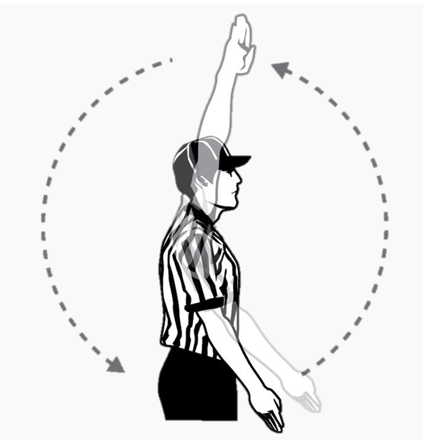
Possession and Release After Face-Offs
“Possession.”
The "off" official will mimic/echo.
What is possession?
Pass
Catch
Cradle
Be slow to call “Possession” on face-offs.
We want a good clear possession.
If a loose ball crosses the restraining line yell “Released"

Slide 5
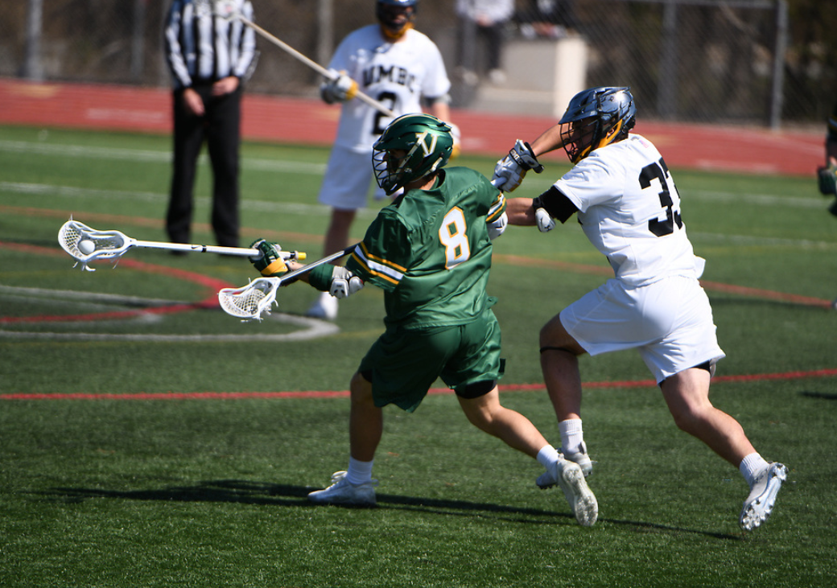
Clearing Counts
Once possession is established:
Trail takes the 20 second clear count to crosses the midline.
Lead takes the 10 second count once possession is established on the offensive side of the midline.
Both Official signal "in the box" by raising hand and pointing to the ground. Counts are over.

Slide 6
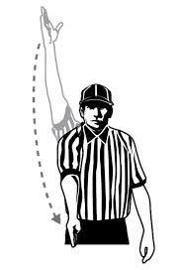
Touch In The Offensive Box
Ball touches into the offensive box.
With or without possession.
Clearing counts are now satisfied.
Over an Back is on. “Midline is hot.”
Arm up, hold it there for a moment.
Make eye contact with your partner if possible.
Make sure your partner sees you.
If he doesn’t, or can’t, verbalize “He’s In.”
Then point down towards the ground.
Partner mimics.

Slide 7
Ball Possessed On Offensive Side
Signal in the Box
Settled Play Begins
“Possession”
Over and Back
is now on
F
T
Signal in the Box
W
L
“Possession”
10-sec count
Notes:
Faceoff Official:
Holds onto the ball and looks to Wing for ready signal
Gives “down” command
Adjusts the players’ bodies and crosses until satisfied
Gives “set” command with hand on the crosses
Backs away and sounds whistle while focused on the faceoff
Wing Official:
Take position roughly 5 yards into the field at end of wing line
Alerts partner of any man-down situations
Signals ready when field is set
Watches for wing midfielders leaving early and interference/holding
Note: The Trail official has the initial count after possession, This allows the Lead official to get to the goal without worrying about the count.

Slide 8
Ball Possessed On Defensive Side
10-sec count
“Possession”
L
W
Signal Touch in the Box
Over and Back is now on.
F
Settled Play Begins
“Possession”
Signal Touch in the Box
Timer Off
T
20-sec Timer on
Notes:
Note: The faceoff official works to stay out of the developing play. If stuck, do not make the situation more dangerous by moving. Allow play to move past you and then hustle to position.
Note: A good discussion in a pre-game is when to reface and when to award via alternate possession; also review when a faceoff is considered to be over according to the rules.

Slide 9
Settled Situations
Both officials must pay constant attention to their positioning and responsibilities. ("On official/Off official)
Keep your eyes on the field and players.
Avoid turning your back to the goal and the field of play.
Keep the players in front of you. Stay wide!
Awareness of on and off ball responsibilities.
Do not get caught ball watching.
Notes:
Discussion: Importance of the On official and Official regarding SAFETY calls
Discussion regarding how to determine who is on or off official off face off.: Ques on the field as determined where play moves.

Slide 10
Lead and Trail – Settled Situation Positions And Responsibilities
Lead
Goal
End Line
Near Sideline
Trail
Shooter
Over and Back
Near Sideline
L
T
Notes:
Lead Official:
Goal is primary responsibility
Positioned roughly a step or two above or below GLE
Covers the end line on contested plays
Trail Official:
Watches the shooter for late hits
Moves toward the goal if the Lead official moves to the end line
Can assist with crease violations on a tight play
Watches for contested substitutions
Makes the over and back call if necessary
Covers the far goal
Note: The pre-game should be clear on each responsibility, but the most important is that the Trail official watches the shooter on every shot.

Slide 11
On and Off Grey Areas
Lead
Everything Else
Illegal Screening
Interference
Off Ball Personal Fouls
Know where the ball is
Trail
Player with Ball
Warding
Moving picks
On Ball Technical Fouls
On Ball Personal Fouls
L
T
Notes:
The shaded areas of the diagram indicate the officials’ areas of responsibility for watching the on-ball action in a settled offensive situation.
Responsible for calling fouls
Defensive fouls against the player in possession
Illegal Holding, Slash, Trip, illegal body check
Offensive fouls against the defense such as
warding, illegal screens, holding defenseman's cross

Slide 12
The Lead Official
Crease/Goal
Know where the ball is
Endline
Sideline
L
Notes:
Primary responsibilities are to cover the goal, crease and end line.
Can move off GLE if there is a contested play behind the goal.
Should be as close to the crease as play will allow without allowing players to get behind him.
Should be in position to call a close play near the crease.
End line responsibility on any shot & chase contested shots to the endline.
Ready to help with Over & Back situations, "YES/NO" and to hustle to the mid-line to restart play if there is an O&B violation

Slide 13
The Trail Official
Shooters/Passers
Crease Area/Off Ball
Know where the ball is
Sideline/Help Down
Midline/Over and Back
T
Notes:
Responsible for watching the shooter/passer for potential late hits after a shot/pass.
Moves towards the goal if the Lead official goes closer to the end line to cover a play.
Helps with crease violations on a tight play.
Does not signal the goal unless absolutely necessary.
Ready to move towards the center line for Over and Back violations.

Slide 14
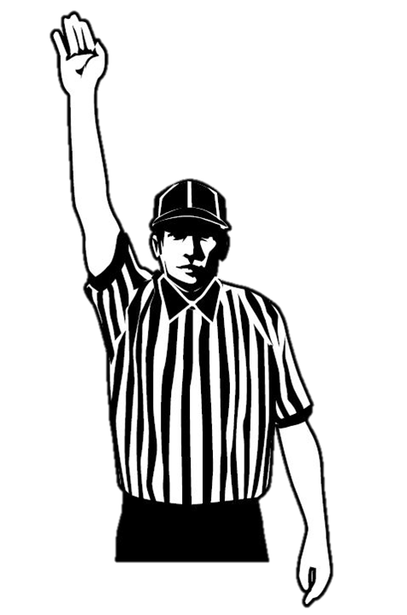
How To Stop Play
Whistle
Arm Up
Notes:
Sound your whistle and signal “dead ball” with one hand over your head
If a player stepped on the sideline or end line, give a sweeping point to the boundary line to indicate that the player stepped out.
Signal the direction of the play by pointing in the direction play will be going and calling the color of the team that now has possession, example “Blue ball” !
add video examples

Slide 15
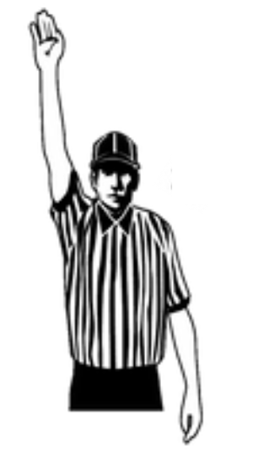
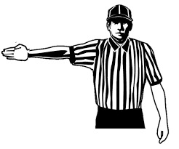
How To Start Play
On Official Off Official On Official
Arm Up Partner gives Ready Signal Whistle and Wind
when ball is coming toward him
Make sure all players are 5 yards away from ball carrier.
When near the Substitution Box, move ball carrier 5 yards onto the field.

Slide 16
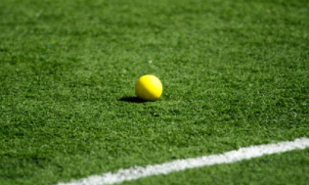
Restarting Play
1. Restart the ball where it went out of bounds, or where the ball was when the previous play was killed.
2. Where the ball will be restarted on the sideline determines who will restart:
TRAIL starts play on their sideline.
EXCEPTION
Transition deep restarts, the new Trail restarts play to allow for the new Lead to get ahead of the play.
Over and Back, new Trail blows the play back in and takes the 10 second count.
LEAD starts play on their sideline.
Notes:
Where the ball will be restarted on the sideline determines who will restart
LEAD starts play on the sideline closest.
TRAIL starts play on the sideline closest
EXCEPT for transition deep sideline clear restarts, the new Trail restarts play to allow for the new Lead to get ahead of the play.
The New Lead can help with a smooth restart by signaling whenthe ball is ready for play by pointing.
Substitution box restart-5 yards out

Slide 17
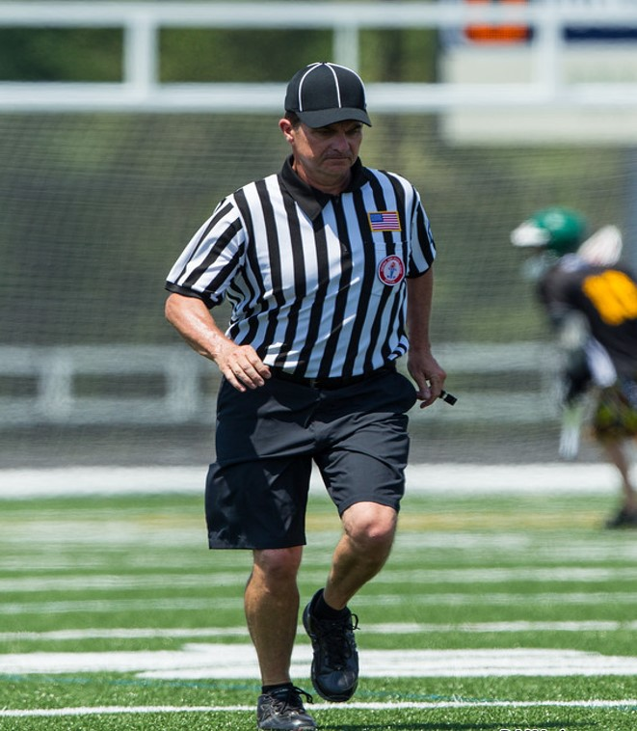
Transition Mechanics
LEAD Sprints
TRAIL Jogs
Stay ahead of play
Stay wide
Have play come towards you
10 second count
Help count players when the ball
is not in your lap.
Whistle the play in
Goalie 4 second count
20 second clear count
Follow the play
Stay parallel with the ball
Stop at the cones/midline
Count Players
Notes:
Responsibilities of each person in transition
Discussion regarding the importance of Anticipation and Hustle to stay in position and be ready for the next play
Video

Slide 18
Shot Out of Bounds Staying With Offense
Lead
Shot!
Whistle
Stop Play
Award Ball
Out of Bounds
White Ball
Trail
Back to Settled Play
Whistle
Start Play
Notes:
Where the ball will be restarted on the sideline determines who will restart
LEAD starts play on the sideline closest.
TRAIL starts play on the sideline closest
EXCEPT for transition deep sideline clear restarts, the new Trail restarts play to allow for the new Lead to get ahead of the play.
The New Lead can help with a smooth restart by signaling whenthe ball is ready for play by pointing.
Substitution box restart-5 yards out
Own your RESTART
Create variety of restart examples

Slide 19
Deep Restart Sideline
Whistle
Start Play
20-sec Timer On
Lead
Trail
PASS!
When Ready
Arm Out
Go Signal
Whistle
Stop Play
Award Ball
Trail
Lead
Out of Bounds
Red Ball
Notes:
Where the ball will be restarted on the sideline determines who will restart
LEAD starts play on the sideline closest.
TRAIL starts play on the sideline closest
EXCEPT for transition deep sideline clear restarts, the new Trail restarts play to allow for the new Lead to get ahead of the play.
The New Lead can help with a smooth restart by signaling when the ball is ready for play by pointing.
Substitution box restart-5 yards out
Own your RESTART
Create variety of restart examples

Slide 20
Restart Out of Bounds in Substitution Box
Lead
Trail
Whistle
Start Play
20-sec Timer On
When Ready
Arm Out
Go Signal
PASS!
Trail
Lead
Whistle
Stop Play
Award Ball
Out of Bounds
Red Ball
Notes:
Where the ball will be restarted on the sideline determines who will restart
LEAD starts play on the sideline closest.
TRAIL starts play on the sideline closest
EXCEPT for transition deep sideline clear restarts, the new Trail restarts play to allow for the new Lead to get ahead of the play.
The New Lead can help with a smooth restart by signaling when the ball is ready for play by pointing.
Substitution box restart-5 yards out
Own your RESTART
Create variety of restart examples

Slide 21
Deep Restart Endline
Whistle
Start Play
20-sec Timer On
Lead
Trail
SHOT!
Whistle
Stop Play
Award Ball
When Ready
Arm Out
Go Signal
Trail
Goalie was closest
Red Ball
Lead
Notes:
Where the ball will be restarted on the sideline determines who will restart
LEAD starts play on the sideline closest.
TRAIL starts play on the sideline closest
EXCEPT for transition deep sideline clear restarts, the new Trail restarts play to allow for the new Lead to get ahead of the play.
The New Lead can help with a smooth restart by signaling whenthe ball is ready for play by pointing.
Substitution box restart-5 yards out
Own your RESTART
Create variety of restart examples

Slide 22
Over And Back
Trail Official
eyes down
ball and feet.
Lead Official help eyes up
technical fouls
NEW Trail restarts play.
NEW Lead
Get in to cover your goal
You can never over-communicate an over & back situation.
“Over and Back”
“Tip! Tip! Tip!”
No running restarts!
Restart the ball where it was when play was killed.
Notes:
The Trail Official is usually in the best position to make this call.
It's best for the NEW Trail to restart play.*
You can never over-communicate as it relates to team’s getting a touch into the attack box or assessing a potential over & back situation.
Don’t allow for an unfair advantage on a restart.
If the ball squirts forward during a play-on and if you have to whistle the play dead, then bring the ball back to midfield for the restart.
Activity: Discuss different restart options and locations
Review: AR/Situation Rule 4 : Rule 4 :14 Art 3 rules and when this is a violation and when it is not
Find videos for discussion (next slide)

Slide 23
Over and Back
Whistle
“Over and Back!”
T
L
Eyes Up
Push/Hold
Interference
10-sec count?
Communicate
Trail may be best
here since he blew it back in.
Eyes Down
Ball
Feet
L
T
Whistle
Notes:
Note: The faceoff official works to stay out of the developing play. If stuck, do not make the situation more dangerous by moving. Allow play to move past you and then hustle to position.
Note: A good discussion in a pre-game is when to reface and when to award via alternate possession; also review when a faceoff is considered to be over according to the rules.

Slide 24
Play On – Technical Foul
Advantage/Disadvantage
Don’t let Play Ons go too long
Offensive player in the crease, kill it right away
Face off Hold or Push, kill it if right away
Play On with a scoring opportunity you can let it play out for a few seconds.
“Play On”
Notes:
The Lead official has the primary responsibility for calling crease violations but the Trail may help.
If there is a crease violation by the offense, such as running or diving into the crease,
The lead official will blow the whistle to stop play
Point to the crease area where the violation occurred
Get the ball ready for a restart.

Slide 25
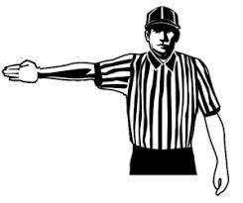
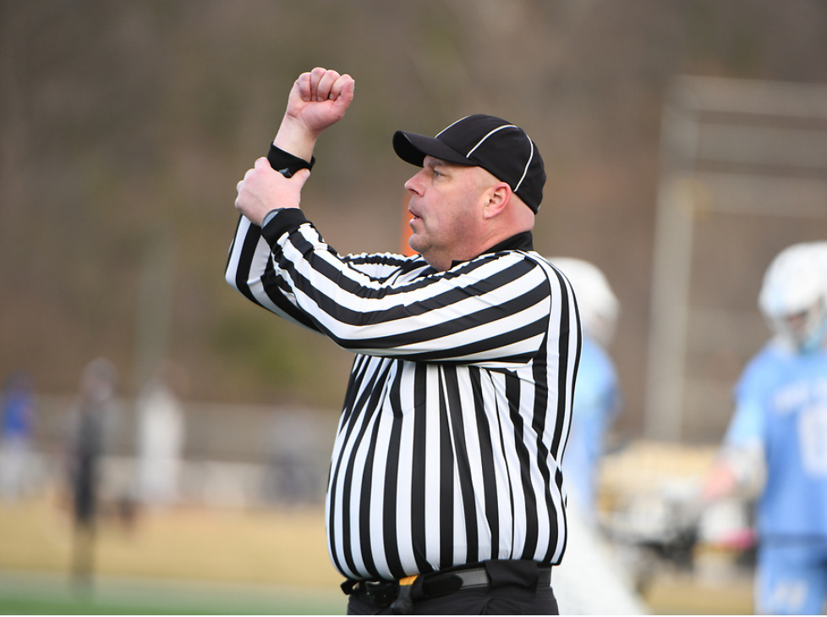
Reporting Penalties
The Trail official will report the penalties.
CNOTE
Color
Number
Offense (with signal)
Time
Explanation (if needed)
Notes:
Discuss big penalties or multiple penalties
The Trail official will report the penalties. "CNOTE"
The Lead official should be getting the ball ready to start play after the reporting official is in position.
Some penalties may require officials to come together for a brief conference.

Slide 26
Good Luck With Your Season
Questions ?

