Slide 1
Crosse and Equipment 2021 NFHS Boys Lacrosse Rules

Slide 2
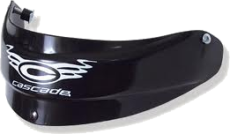
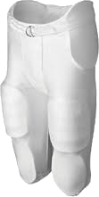
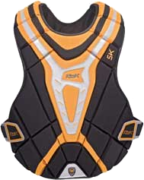
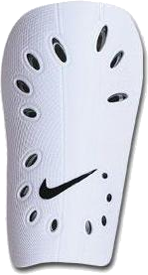
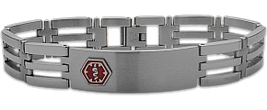
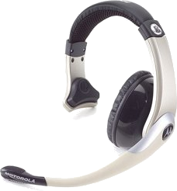
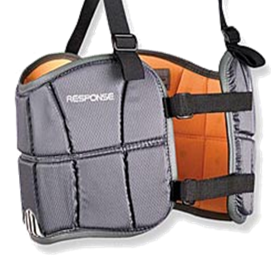
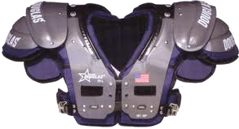
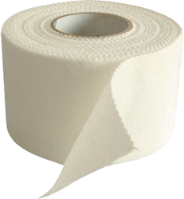
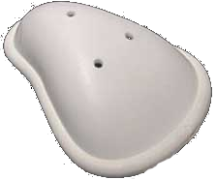
Prohibited Equipment
Prohibited
Allowed
Recommended
Rule 1:10
Notes:
Rule 1:10
Rule 1-9-2e A protective cup is recommended for all HS players.
NO Jewelry (religious or medical I.D. bracelets must be taped. NO electronic communication. Field players may NOT wear football pants, but may wear shin guards, chest and throat protectors.
NO football helmets or shoulder pads or hockey goal keeper gloves. No item that obscure the numbers on the Jersey.
Hard splints/casts may be worn if Dr.’s notice and covered with ½” thick closed cell foam.

Slide 3
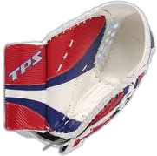
Goalkeeper Equipment
Prohibited
Required
Required in youth
Rule 1:10-d
Notes:
Rule 1:9 d
Remind them that a legally equipped goalie is REQUIRED to allow the game to be played.

Slide 4
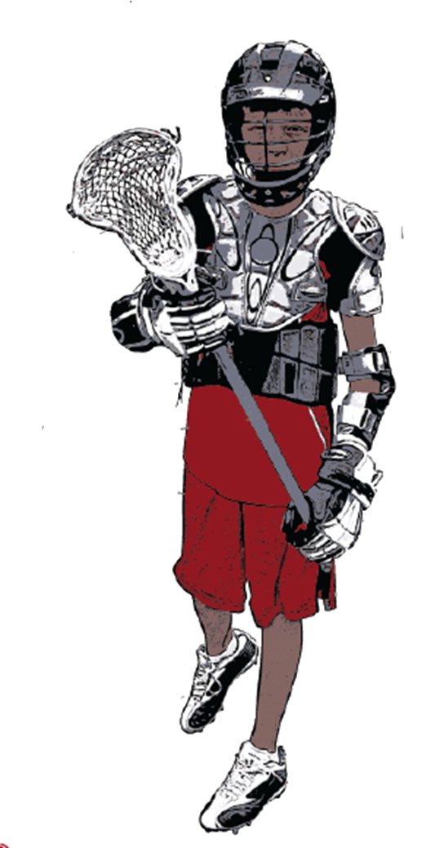
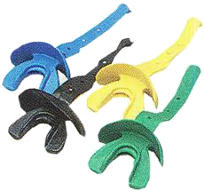
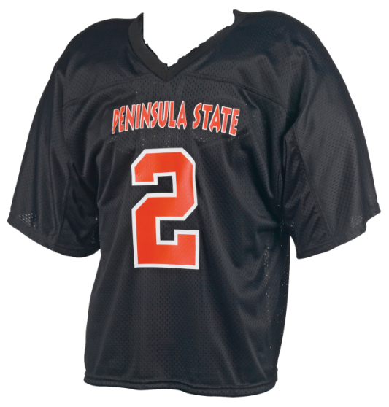
Required Field Player Equipment
Helmet
Crosse
Jersey: Home Team light Visitors dark
Rule 1-9-1g
NEW IN 2018
Shoulder Pads
Mouthpiece: any color EXCEPT White or Clear
Arm Pads
Rule 1-9-1 g (8) Beginning in 2022, the home team will be required to wear white, rather than light colored, jerseys.
Gloves
Shorts
Cleats
Rule 1:9
Notes:
Rule 1: 3
Overview of all the equipment required. Youth and HS.
Rule 1-9-1g (8) better defines home and away jerseys.

Slide 5
Chest Protector
Beginning January 1, 2021
Goalkeeper chest protector designed for lacrosse that incorporates the NOCSAE ND200 at the time of manufacture.
Rule 1.9.1j
Notes:
ART. 1… j. Goalkeepers shall wear.
1. Throat protector designed for lacrosse.
2. Chest Protector. Beginning January 1, 2021, a goalkeeper chest protector designed for lacrosse that incorporates the NOCSAE ND200 at the time of manufacture.
Rationale: Protection for the athlete against cardiac issues related to Commotio cordis.
Change to 2021 added in 2019

Slide 6
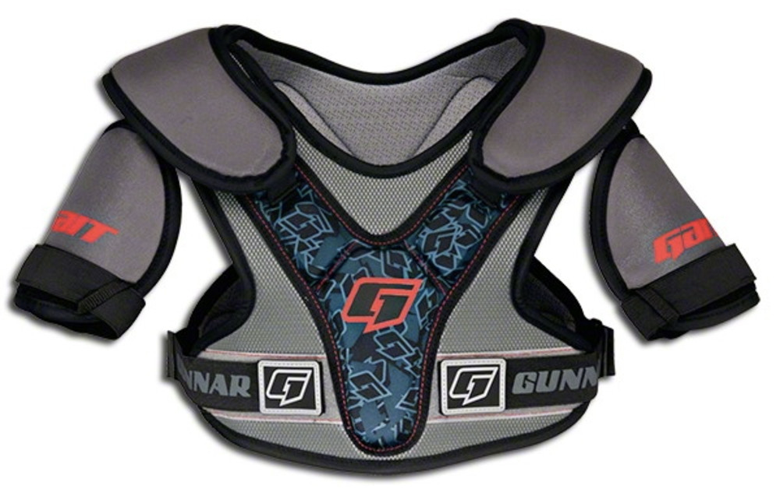
Shoulder Pads
Beginning January 1, 2022
Shoulder pads designed for lacrosse must meet NOCSAE ND200.
Rule 1.9.1j
Notes:
ART. 1… j. Goalkeepers shall wear.
1. Throat protector designed for lacrosse.
2. Chest Protector. Beginning January 1, 2021, a goalkeeper chest protector designed for lacrosse that incorporates the NOCSAE ND200 at the time of manufacture.
Rationale: Protection for the athlete against cardiac issues related to Commotio cordis.
Change to 2022 added in 2020

Slide 7
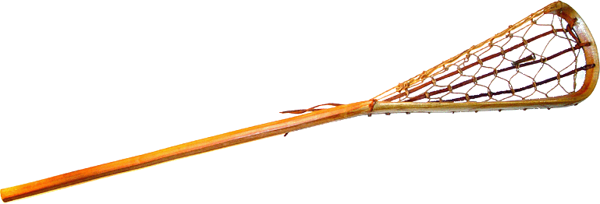
Crosse Requirements
Wood, laminated wood or synthetic.
Hollow handles must have manufactured plug.
Length: 40” to 42” OR 52” to 72”
Handle must be “relatively straight.”
not < 3.5” in circumference.
Net can be gut, rawhide, linen or synthetic material woven in triangular shape; may not ensnare.
A broken crosse is not a crosse.
Rule 1:6-8
Notes:
May not be made so as to snare opponents crosse. Side wall can be of weaving gut lacing.
Emphasize a broken crosse is not a crosse so that person is no longer a legally equipped player.
Rule 4-3-3n now specifically states the circumference of the shaft shall not exceed 3.5 inches, and a contrasting color between the head and the top glove must be visible on the shaft during faceoffs (it may be tape or paint).
Adjustable handles are illegal Rule 1:7

Slide 8
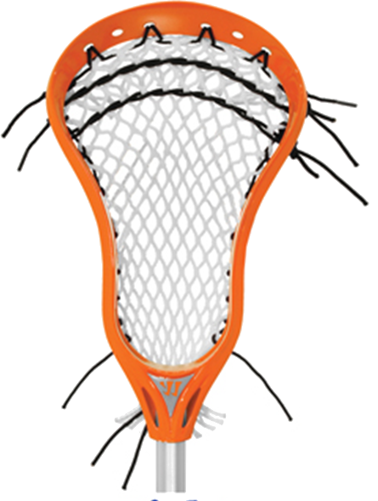
The Head of the Crosse
Scoop
Shooting Strings
Sidewall
Mesh
Ball Stop
Maximum of 2 inches in length,
1½ inches in width and ¼-inch in thickness.
Not Required
Neck
Throat
Only 1
Rule 1:6-8
Notes:
Ballstop

Slide 9
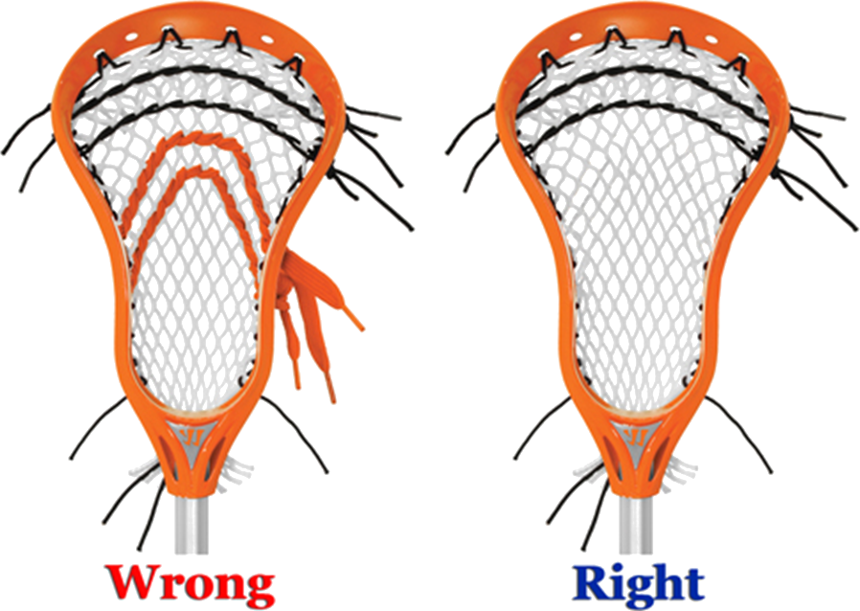
Shooting Strings & Sidewalls
Shooting strings must be located within 4” inches of the top of the crosse.
No more than one side wall string on each side is allowed.
2-minute NR
Rule 1-7-3
Notes:
Discuss the rationale for this change. Ball has become too difficult to dislodge, so what do defenders resort to: more reckless stick and body checking.

Slide 10
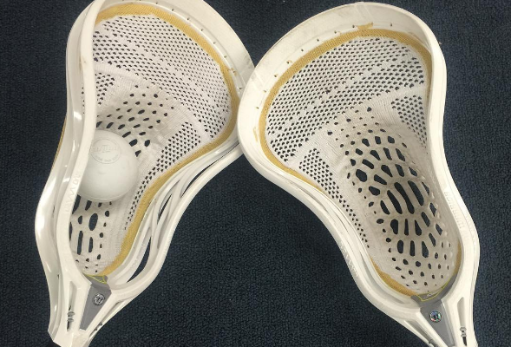
Nontraditional Synthetic Pocket
Pockets of nontraditional synthetic material manufactured for lacrosse are permitted.
Rule 1.7.5
Notes:
Page intentionally left blank

Slide 11
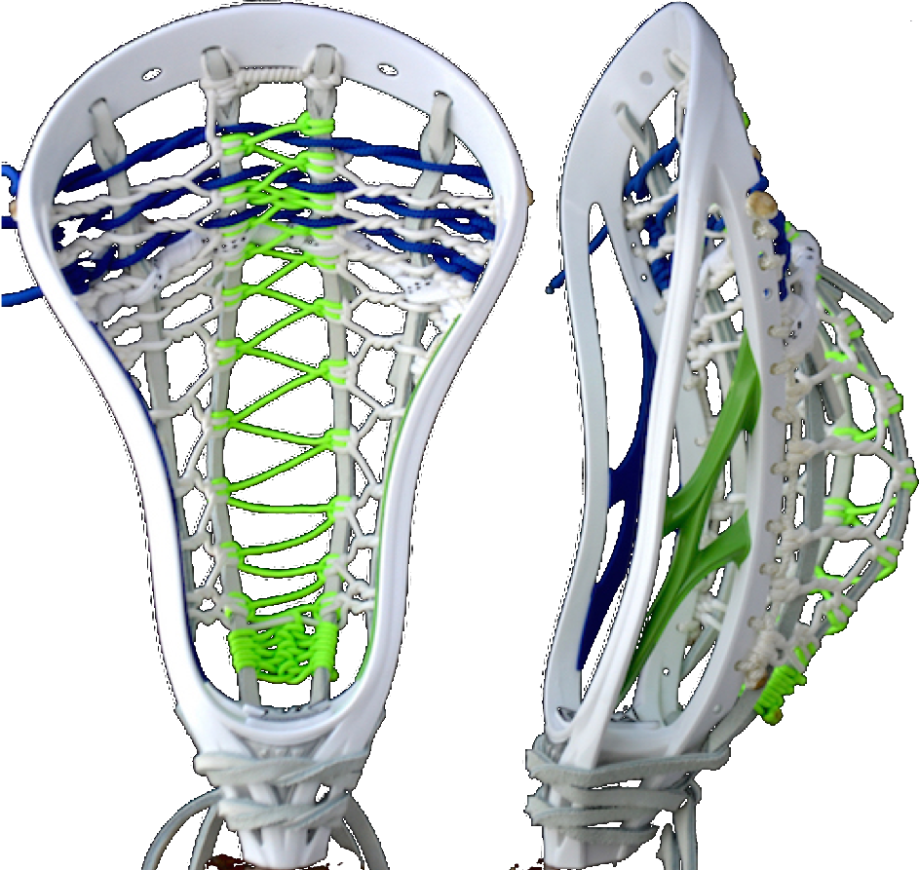
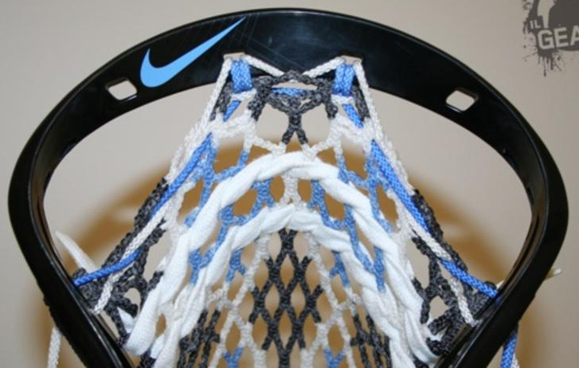
Pocket Construction
The pocket/net must be completely attached to the head and the side walls, leaving no gaps large enough for a ball to pass through.
Rule 1.7.1
Notes:
ART. 1… The crosse shall be made of wood, laminated wood or synthetic material, with the head approximately perpendicular to the handle. The side wall opposite the wood wall may be made by weaving gut lacing from the tip of the head to the handle, strung in such a manner as to prevent the tip from catching on an opponent’s crosse; or both walls may be of wood, laminated wood or synthetic material. The stop shall be constructed so that the ball shall rest on the stop. The net of the crosse shall be constructed of gut, rawhide, linen or synthetic material and shall be roughly triangular in shape. The longitudinal weaving shall be attached at the back of the throat of the crosse. The pocket/net must be completely attached to the head and the side walls, leaving no gaps large enough for a ball to pass through.
Rationale: Eliminates stringing techniques that could create an unfair advantage.

Slide 12
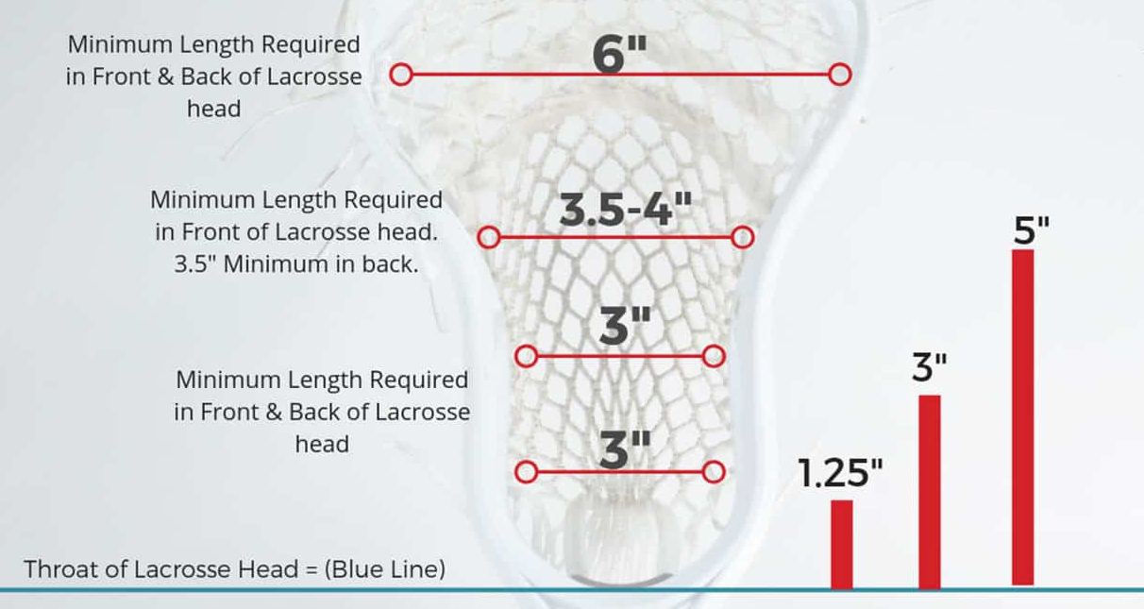
Crosse Specifications
Rule 1.6.1
Notes:
Measure from front 1:6-2

Slide 13
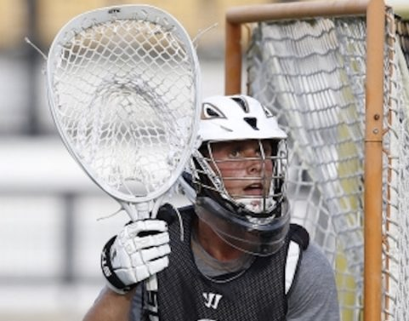
Goalie Crosse Specifications
Only one Goalkeeper crosse on field a at a time.
Length: 40”-72”
Width: 10”- 12”
Pocket may be deep.
No shooting string restrictions.
DON’T CHECK
Rule 1.6.1
Notes:
NEVER CHECK A GOALIE CROSSE UNLESS A COACH REQUESTS!

Slide 14
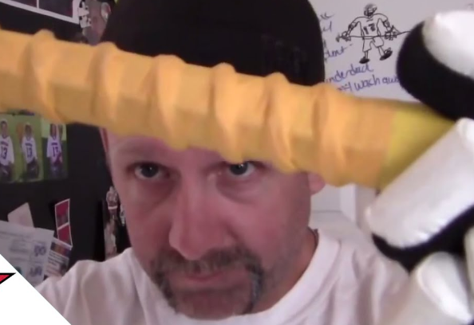
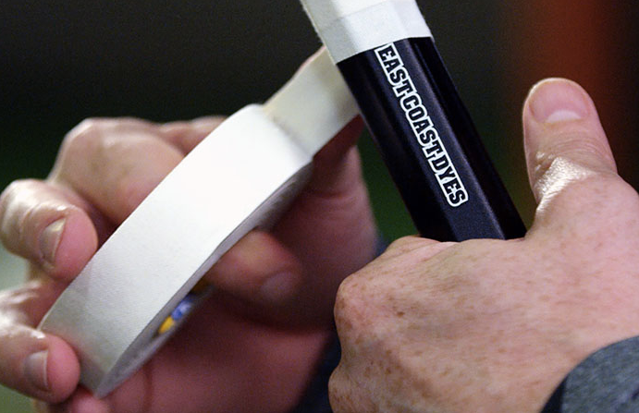
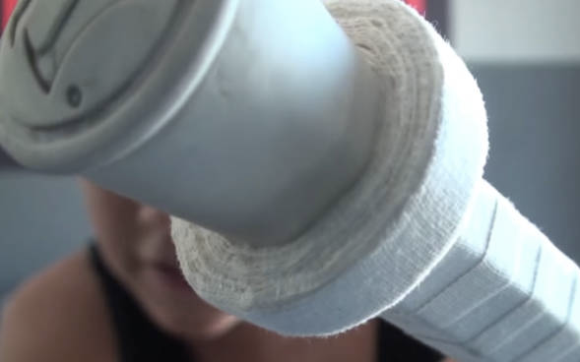
Tape on Crosse
Tape is allowed on crosse.
Crosse used in a faceoff may not have tape on head.
Tape ring > 3.5” may not be more than 3” from butt end.
Rule 1.6.1
Notes:
Tape ring is a get off an fix.

Slide 15
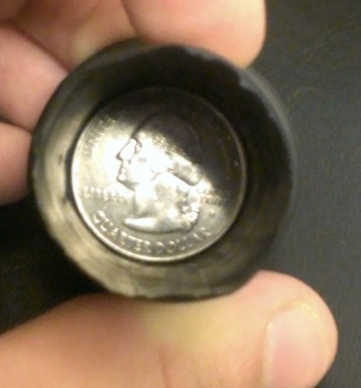
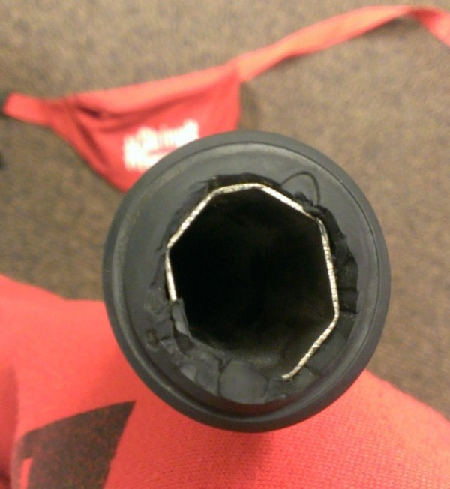
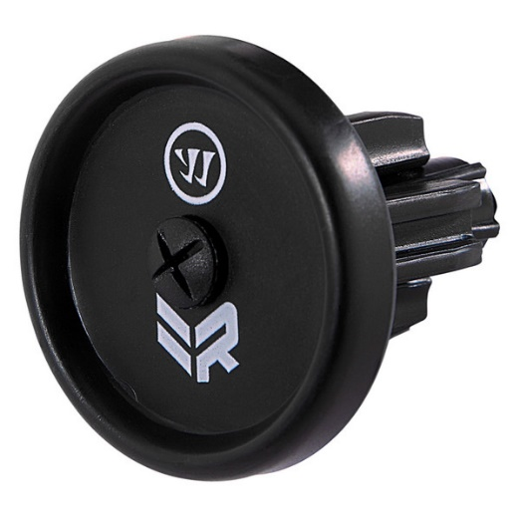
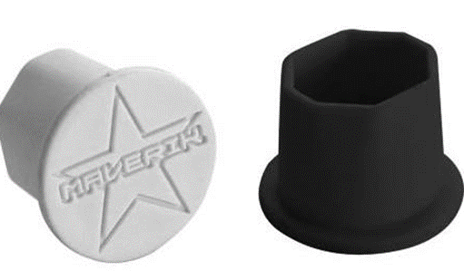
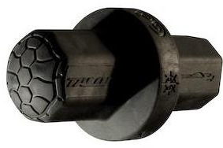
End Caps, Tape Rings
Hollow crosse handles must have their open end covered with an end cap manufactured for a lacrosse stick.
Get Off & Fix
Rule 1: 7-3, 1:6-1
Notes:
Warrior Rabil Power Large Lacrosse Stick Donut End Cap
Tape ring more than 3” from butt end Rule 1:6-1

Slide 16
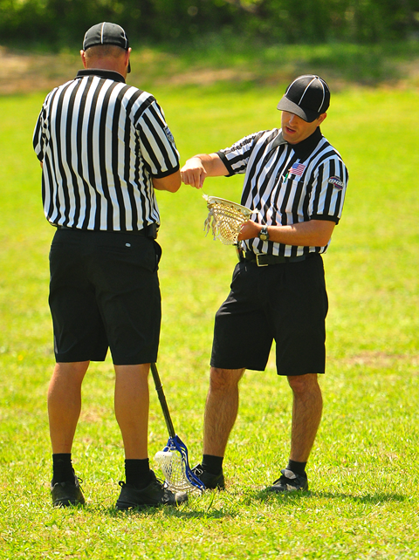
Equipment Inspection
Two per team, per half:
During a team time-out.
After a goal.
Before a face-off.
Between periods.
Check ALL required equipment.
Make sure no one in the box.
Rule 4:27-2
Notes:
Choose player that has impacted the game, but anyone may be checked.
The player need not be on the field at the time for the official to request his crosse (DON’T enter team huddles).
Inspect player’s crosse away teams and coaches. Face away from bench. If there is a potential issue, confirm and discuss with the R. DO NOT demonstrate what was illegal with stick to coach or players.
Good, close and oh crap. Don’t look for trouble.

Slide 17
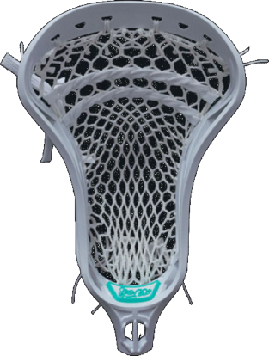
Measuring the Head of the Crosse
Measured the head from the front face
Must be a minimum of 10”
Regardless of whether a ball stop is used
Rule 1:6-2
Notes:
Rationale: Clarifies this crosse measurement is to be made on the front face of the head.

Slide 18
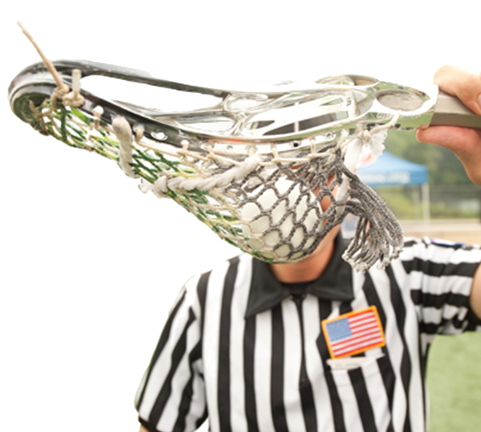
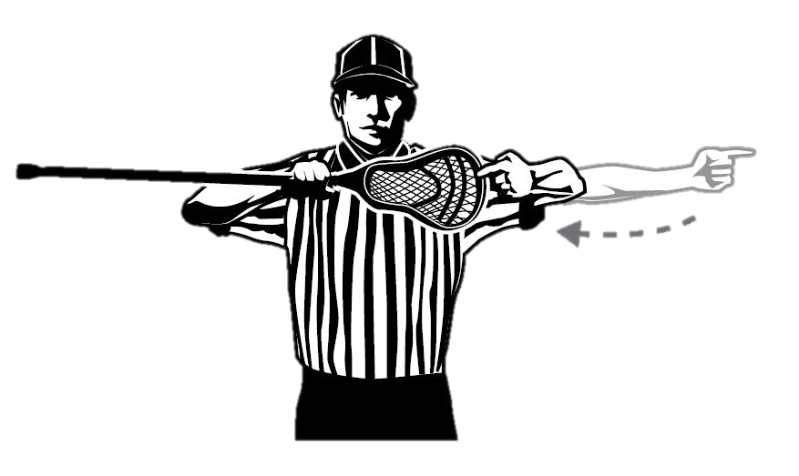
Place the ball in the pocket and hold the stick at eye level. If you can see space between the ball and sidewall, it is illegal.
2 minute NR
Deep Pocket
Rule 5:5
Notes:
This is the ONLY 1 minute NR penalty on a crosse. The crosse can return to game once the penalty has been served. For the legal pocket, the top ball must be at least a bit above the bottom edge of the sidewall. Or, put another way, the pocket is illegal if the top surface of the lacrosse ball, when placed in the pocket, is below the bottom edge of the sidewall. .

Slide 19
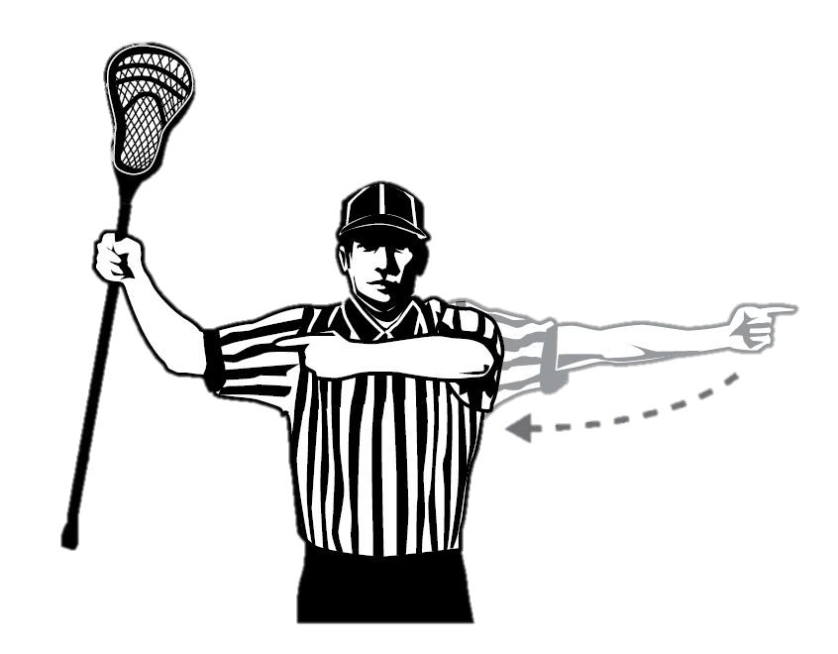
Illegal length or altered.
Intention is irrelevant.
2 min NR
Illegal Crosse
Rule 5:5
Notes:
USC for adjusting stick prior to handing it to official in addition to any additional fouls.
Most common: Pinched head; fails roll out test.

Slide 20
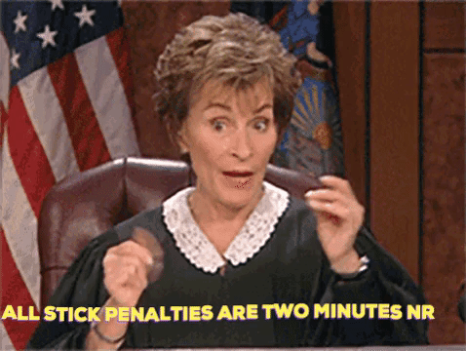
Penalty for All Illegal Crosse
All illegal crosse penalties are two-minute, non-releasable.
All sticks can be fixed and return to play.

Slide 21
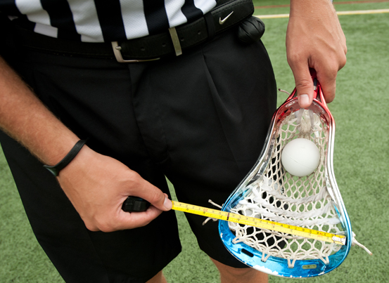
Head coach may request inspection of any player’s crosse & equipment.
Must request by number.
During a dead ball.
All equipment inspected.
Subsequent requests that fail: Time Out charged or, if none, an IP penalty assessed.
Request for Equipment Inspection
Rule 4:27
Notes:
Like the challenge flag in the NFL

Slide 22
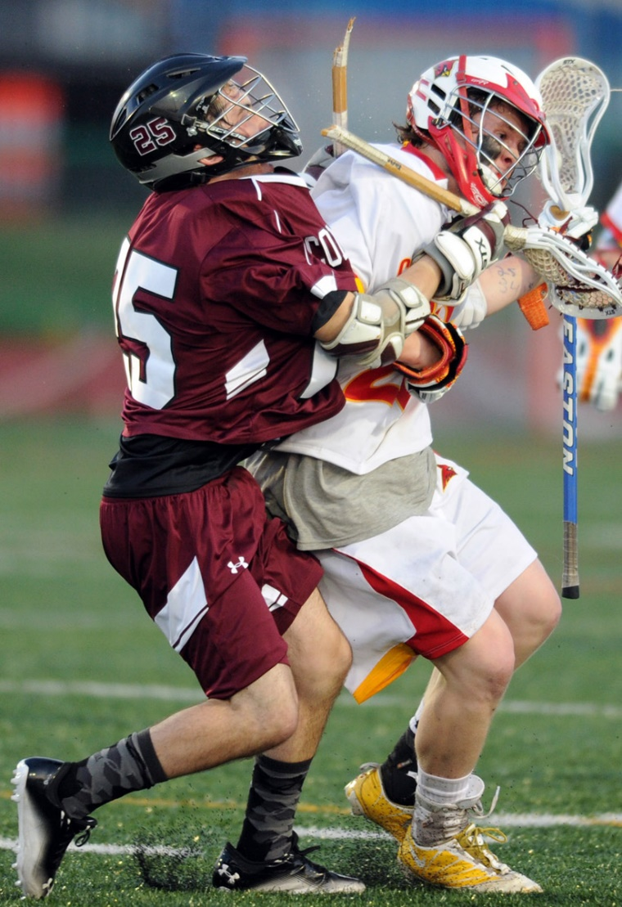
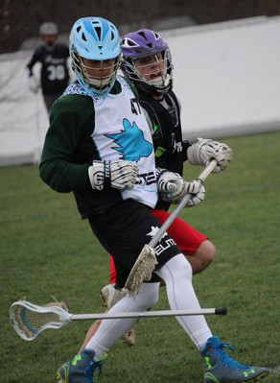
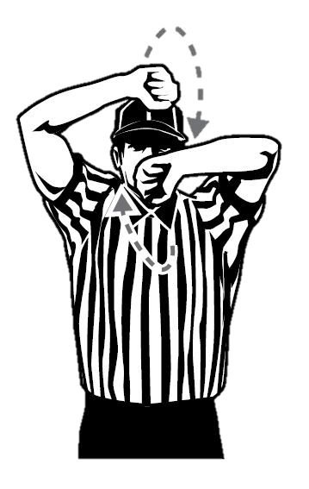
Lost or Broken Equipment
STOP PLAY immediately if a player loses or breaks mandatory equipment other than the crosse in a scrimmage area.
A broken crosse not a crosse.
Rule 1:9-3; 4:20-2, 6:5-2
Notes:
If goalie breaks his crosse or loses or breaks any other required equipment, stop play immediately (allow shot in flight to conclude).
Award possession as with inadvertent whistle.
USC for intentional lost equipment to stop play.
Goalie playing without crosse is a technical foul.
USC for intentionally goalie puling down cage to stop play.
What does participation mean?

Slide 23
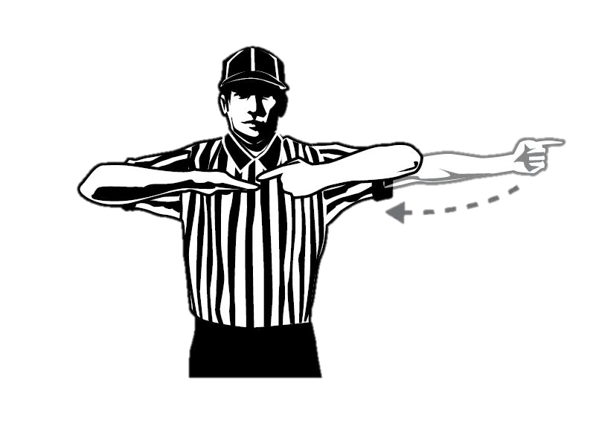
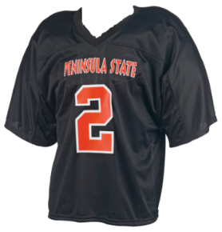
Illegal Equipment
Not wearing required or prohibited equipment: 1 minute NR (for all violations).
No mouthpiece: stop play, 30 second technical, unless official KNOWS it came out during play.
Improper uniforms: 1 technical foul for all violations.
Illegally equipped substitutes: sent off!
Rule 5:6, 6:5-x, 6:5-3
Notes:
If goalie breaks his crosse or loses or breaks any other required equipment, stop play immediately (allow shot in flight to conclude). Uniform violations NOT an issue in YOUTH.
Award possession as with inadvertent whistle.
USC for intentional lost equipment to stop play.
Goalie playing without crosse is a technical foul.
Once game starts no more uniform violations.

Slide 24
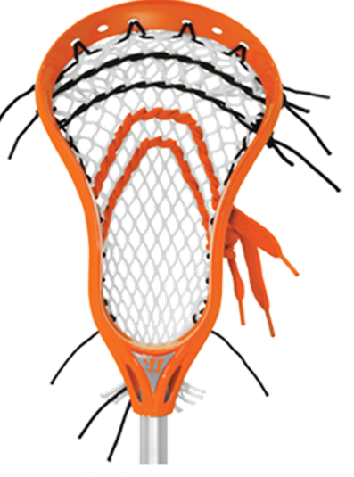
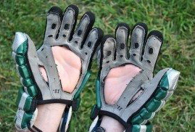
Illegal Equipment + Illegal Crosse
1 minute NR
2 minute NR
Rule 5:6 C
Notes:
Multiple instances of illegal or prohibited equipment are one violation
Always assess worst violation.
Altering crosse prior to a request for inspection is the exception.

Slide 25
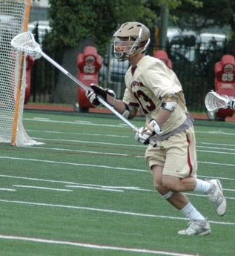
Illegal Number of Long Crosses
Maximum 4 long crosses.
Coach may call for a double horn at the next dead ball if he believes the opponents have too many.
>4
Rule 4: 28
Notes:
As with equipment inspections, he gets one “free” request of this kind, and further violations are punished with the loss of a time-out or, if no time-outs remain, with a technical foul.

Slide 26
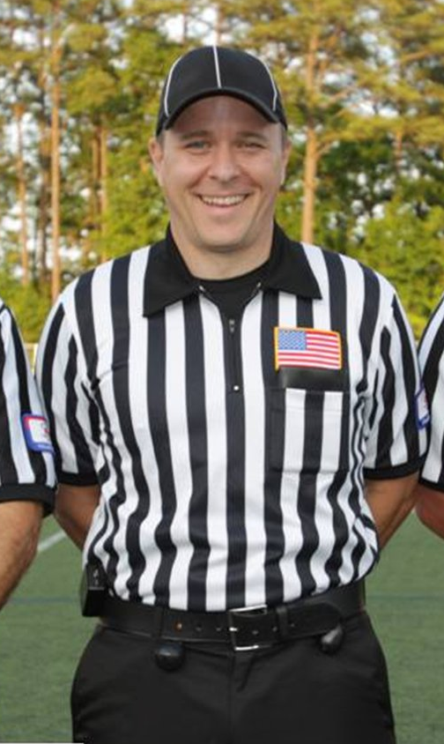
Greg Hite GLOA Lead Trainer US Lacrosse Clinician c: 770-689-9782 e: ATL.LacrosseRef@gmail.com
Presentations are available online at galaxref.com

